Slide 1

DCC Spring Training Days 2026
Data Discovery and Evaluation
Renate Mattiszik, Marta Kargól
Saxion UAS
02 June 2026

Slide 2

This presentation has been produced in collaboration with Saxion and DCC-PO (working group “zoeken en vinden van onderzoeksdata”):
Inge Boot van Hogeschool Rotterdam,
Anne-Marie van Boeckel van Hanze Hogeschool,
Esther Goedegebuure van Hogeschool Zeeland,
Renate Mattiszik en Marta Kargól both from Saxion

Slide 3
Schedule
09.30 - 09.45 | Opening
09.45 - 10.00 | Introduction
10.00 – 10.25 | Where do I search?
10.25 - 10.35 | Search and documentation
10.35 - 10.55 | Exercise 1
10.55 - 11.10 | Evaluation exercise 1
11.10 – 11.25 | Break
11.25 - 11.50 | Assessing datasets
11.50 - 12.10 | Exercise 2
12.10 - 12.25 | Evaluation exercise 2
12:25 – 12:30 | Wrap-up

Slide 4

Opening and Introduction
Stand in order of travel time.
Arrange in alphabetical order by your institution name.
Stand in order of the number of students at your institution.
Stand in order of the number of researchers at your institution.
Form groups based on the job titles you have.
Stand in order of the number of years you have held this position.
What do you expect to learn?
Notes:
Renate

Slide 5
What are we going to cover?
Introduction
Where do I search?
Search and documentation
Assessing datasets
Definition of reusing data
Data repositories
Documentation
FAIR principles
Why and When?
Other data sources
Selection
Quality of data

Slide 6
Introduction

Slide 7
Definition
In this context, data reuse refers to the use of data previously collected within research projects or other sources for your ongoing research project. Examples of data that can be reused include:
  Datasets from previous research (whether your own or someone else’s) Policy research Patient records Business data Public sector data Data from non-academic institutions

Slide 8
Why reuse data?
  Cost-saving Time-saving Sustainability Reducing the burden on target groups: specific groups are surveyed less frequently
  Ethical considerations (where the research has an impact on participants, animals, the environment, etc.) Accelerating scientific developments Enhancing your own dataset by combining it with existing data Encouraging collaboration between different researchers/disciplines Increasing the scope for international and longitudinal research

Slide 9
What can you reuse data (documentation) for?
  To answer new research questions To validate (reproducibility) To build new data models (Data Science) To justify collecting or producing new data To use other datasets as comparative material To cite relevant datasets In data documentation, to adopt someone else’s method or to draw inspiration

Slide 10
Workflow
At what stage of the research cycle do you look for the data?
Idea/Grant application/Exploratory phase:
  Justify the need to collect new data Explain the applicability of the dataset Inspiration
Literature review: to cite relevant datasets
Analysis: other datasets for comparison

Slide 11
Where do I search?
Notes:
Marta

Slide 12
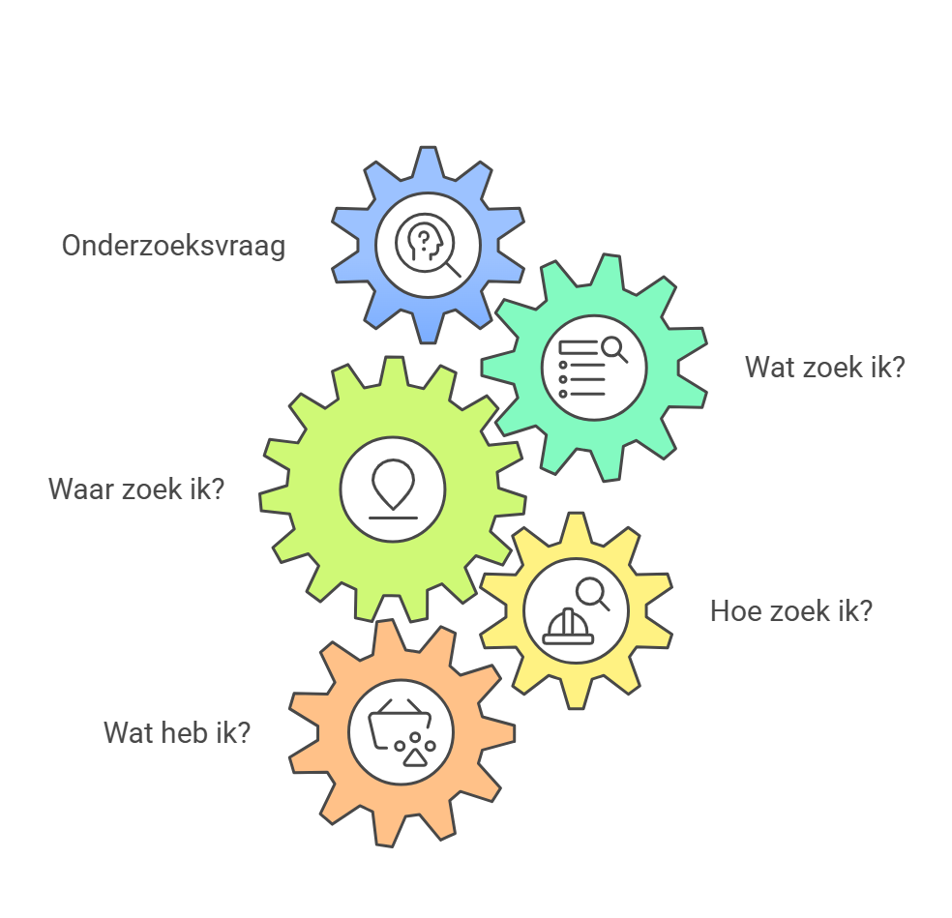
Search strategy for datasets vs. search strategy for literature
Napkin. AI

Slide 13
Defining your search strategy step by step
What is your research question?
What kind of data (documentation) do you need (qualitative, quantitative, survey templates, etc.)?
What variables do you need (age, gender, occupation, etc.)?
What do you want to do with the data?
Which keywords will you use to search?
In what context?
  Subject Geography Time period in dataset Time period of data collection Target audience Metadata standard Open Access (licence)

Slide 14
Where do I search: an overview
Your institution’s data repository
General search engines
Domain-specific search engines
Dutch data repositories
International data repositories
Other databases
Data Journals
Scientific literature
Network

Slide 15
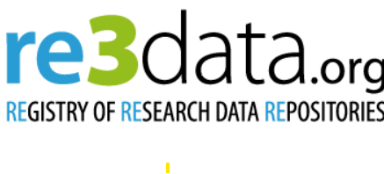


Selecting data repositories
Re3data : filtering options, data repository characteristics
OAD data repositories: alphabetic list by subject area
FAIRsharing.org: filtering options, policies and standards

Slide 16
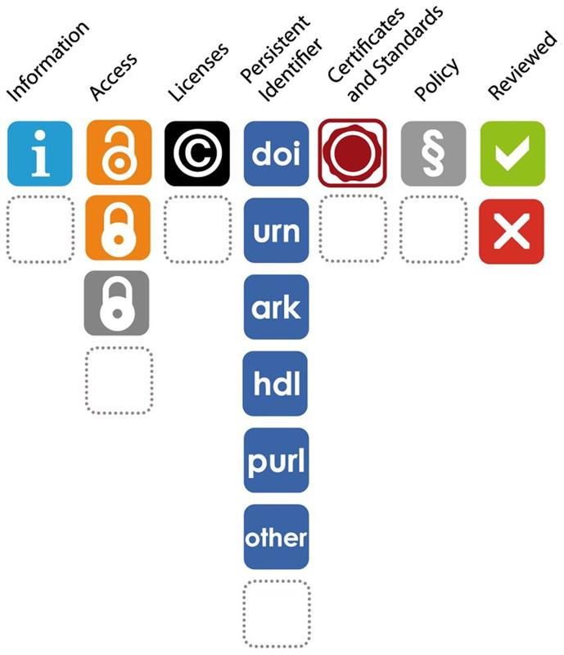
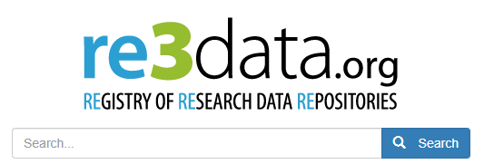
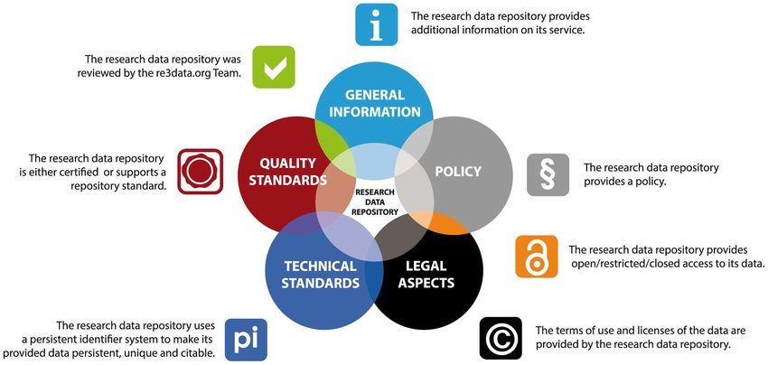
Images: Pampel H, Vierkant P, Scholze F, Bertelmann R, Kindling M, et al. (2013) Making Research Data Repositories Visible: The re3data.org Registry. PLoS ONE 8(11): e78080. doi:10.1371/journal.pone.0078080

Slide 17
Examples of search engines
General search engines
Domain specific search engines (social sciences)
DataCite Commons
Portal Odissei
Dataset Search
CESSDA

Slide 18
Examples of search engines
Dutch data repositories
  Dans Data Stations
  Dataverse.nl
  4TU.Research Data
International data repositories
  Dryad
  OSF
  Zenodo

Slide 19
Other sources: examples
Public sector data
Open data platforms
Overheid.nl
Kaggle
Hugging
CBS Open data (StatLine)
World Bank Group
RIVM
OECD

Slide 20
Data journals & literature search
A peer-reviewed article that discusses a data collection rather than the research results.
A journal that publishes articles that are entirely or partially dedicated to datasets. This document describes a dataset that compiles information on 135 journals.
Data paper
Data journal
Data Avaibility Statement
Where it is not possible to share data openly due to ethical or legal considerations, many journals (scientific journals) require a description of where the data can be found and under what conditions it is accessible. This is often referred to as a ‘data availability statement’. Journals sometimes provide various examples of such statements on their own websites.

Slide 21
Search and documentation

Slide 22
  A systematic review is not possible
  When searching for data, filters play a greater role than keywords
  A similar strategy is possible
  Documenting the search strategy and search results is recommended in both cases
Searching for data vs. searching for literature

Slide 23
Documenting the search process
You can document the following aspects during your search process:
  The repository and/or search engine used (write down all information about the usability, features, and relevance of a repository for your research question)
  Search terms and filters used Number of results found Date Evaluation of your search process and any improvements you made

Slide 24
Exercise 1:
Think of a topic or theme
Go to Re3data and select the relevant data repositories
Choose one repository and search for relevant datasets
Go to DANS Data Stations and search for relevant datasets
How did you search? (keywords, filters, etc.)
Keep the datasets you found in mind for the next assignment
What has your experience been like? What challenges have you faced? What went well, and what didn't?

Slide 25
Evaluating datasets
Notes:
Renate

Slide 26
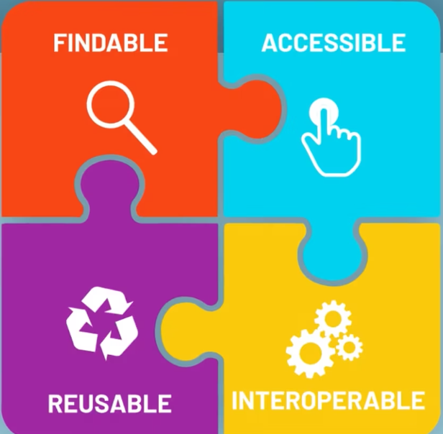
FAIR principles
FINDABLE
ACCESSIBLE
REUSABLE
INTEROPERABLE

Slide 27

Access terms and licenses are clearly stated
Access terms of the data providers or research partners
Notes:
Secured Environment Blind analysis
Voorbeeld: CBS microdata
Secure Analysis Environment (SANE)
Decentralised analysis Data in de handen van de eigenaar
Analyse op basis van protocol
Uitgebreide metadata en data documentatie

Slide 28
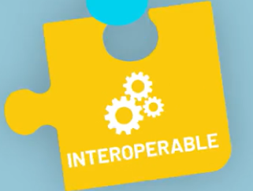
Metadata standards
Variable descriptions (legend)
Consistency in descriptions
Coding of response options
Units of measurements
...

Slide 29
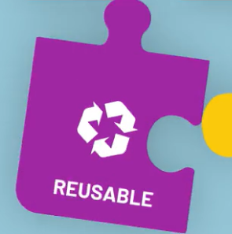
Data documentation
Licenses
File Formats

Slide 30
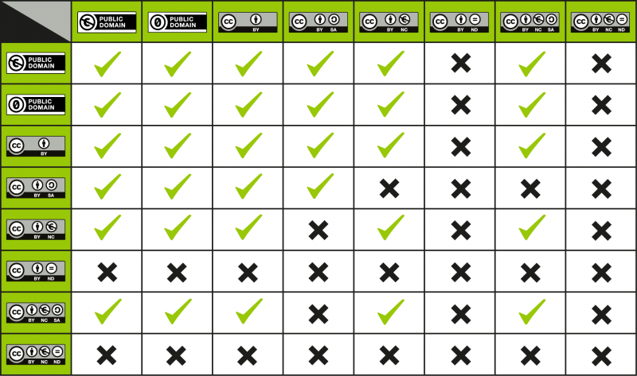
Licenses: Merging two existing datasets
Source: Wiki/cc license compatibility - Creative Commons

Slide 31
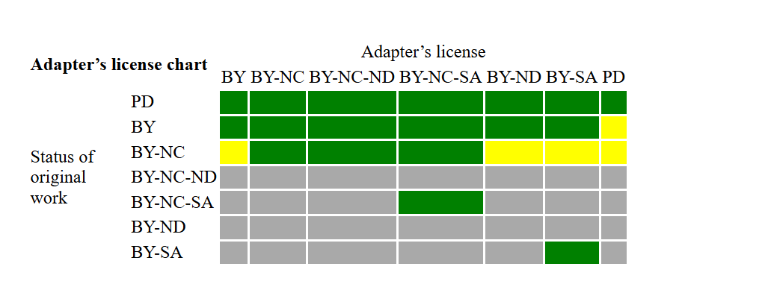
Adding existing datasets to your own dataset
When you publish a modified dataset, your choice of a new license depends on the license applied to the original dataset. The following chart shows your options:
• Green: Licenses that you may apply to modified data originally covered by a specific license.
• Yellow: Legally permitted, but not recommended
• Gray: Licenses that you may not use
Source: https://creativecommons.org/faq/#when-is-my-use-considered-an-adaptation

Slide 32
Quality of data
Author’s background
Author’s affiliation
Quality of publications based on the dataset
Quality of the data repository
Metadata quality, README, data documentation
Compliance with legislation
Notes:
Ethische toets?

Slide 33
Documenting found data sets
Once you have found datasets, you can document the following:
  Database/repository/organization Accessibility of the dataset (open, under embargo, restricted, closed) Persistent identifiers (e.g., DOI) Date of discovery You can add the datasets to your reference manager (manually)

Slide 34
FAIRness check : F-UJI
https://www.f-uji.net
A web service that assesses the FAIRness of research data objects at the dataset level based on the FAIRsFAIR Data Object Assessment Metrics

Slide 35
Data citation
  Data repositories often provide examples of data citations
  Cite the data according to the citation style guidelines you are using in your article
  Check the requirements of the journal in which you plan to publish
  More info: https://www.dcc.ac.uk/guidance/how-guides/cite-datasets

Slide 36
Exercise 2
Evaluate a dataset for usability
FAIR principles
Data quality
Can the datasets be combined if you want to publish your own dataset under a CC BY license?
Cite your dataset.

Slide 37

Wrap-Up
What is your main take away and what is your first step you will take?

